Slide 1
Data Structures
_ ×
Advanced Java
Ja-Hee Kim@seoultech

Slide 2
Contents
01
02
Model
Multiple Classes & Interfaces
03
04
Array
Generics

Slide 3
Data Structures . Advanced Java
Model

Slide 4

Model Our Lives
How to manage animals using a computer
You should model what you want to manage using a computer.
What do you need to consider to model it?
Abstraction
How to model them in detail?
Encapsulation
What do you want to let externals to know and not
know about it?
Inheritance
Commons with and differences from others,
Scientific classification

Slide 5


Abstraction
Concrete
abstract
Instance
class
abstract class interface UML model ADT
Developing process

Slide 6
ADT
Abstract Data Type
What do all have in common?
Computer stores/organizes items in similar manners as the exam ples
An ADT specifies
description of a target object
data that is stored
operations that can be done on the data
Parameter: we should know for doing
pre-condition: should be satisfied before the operation
post-condition: become satisfied after the operation
Return: return information

Slide 7
Example of ADT
-
X
Dog
Responsibilities
Eat: It can eat given food when it is hungry Run: It can run fast
Bark: It can make the sound “bowwow”
Collaborations
The owner can make the dog eat, run and bark.

Slide 8
Example of ADT
 | Eat | Run | Bark
Pre-condition | hungry | Full
Post-condition | Full | Hungry
Parameter | Feed
Return |  |  | sound

Slide 9
Example of ADT
A Dog is a species of animal.
void eat(Object feed)
It can eat given food when it is hungry
Precondition: it is hungry
Post-condition: it is full
void run()
It can run fast
Precondition: it is full
Post-condition: it is hungry
Sound bark()
It can make the sound “bowwow”
Return: return “bowwow”

Slide 10

UML
Unified Modeling Language
graphical language used for designing and documenting OOP software
UML Class Diagrams
The top section contains the class name
The middle section contains the data specification for the class
The bottom section contains the actions or methods of the class
Name
Data
Method

Slide 11



UML
Provides a class diagram
Class name: dog
Attributes: breed, isHungry
Operations: eat, run, bark
Dog
isHungry
eat(feed) run() bark():Sound

Slide 12


interface
interface IDog {
IDog
isHungry
eat(feed) run() bark():Sound
public void eat(String feed); public void run();
public Sound bark();
}

Slide 13

Abstract class
IDog
ADog
isHungry
eat(feed) run() bark():Sound
abstract class ADog
implements
IDog{
boolean isHungry;
public void eat(String feed) {
isHungry = false;
}
public void run() {
isHungry = true;
}
public
abstract
Sound bark();
}

Slide 14
class
ADog
Dog
isHungry
eat(feed) run() bark():Sound
class Dog extends ADog {
public void eat(String feed){/* how to eat */} public void run() {/* how to run */}
public Sound bark() {
/* how to bark */ return sound;
}
}

Slide 15
instance
Dog
isHungry
eat(feed) run() bark():Sound
Dog ddangchil = new Dog(); ddangchil.run();

Slide 16
Data Structures . Advanced Java
Multiple
Classes Interfaces

Slide 17
Agenda
Overriding vs Overloading
Polymorphism
Inner class
Static
Variable
Methods

Slide 18
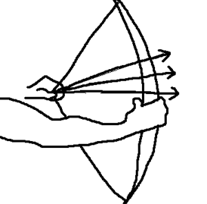
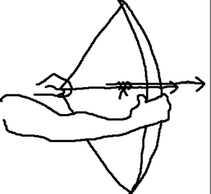
Overriding vs overloading
Overloading
The same name of method in one class with different parameter
Overriding
The same name of method in a parent class and its child class
Animal
+makeSound()
Dog
+makeSound()
+makeSound(String emotion)
overloading
overriding

Slide 19


polymorphism
The ability to associate many meanings to one method name
It does this through a special mechanism known as late binding or dynamic binding
Meow
bowwow

Slide 20
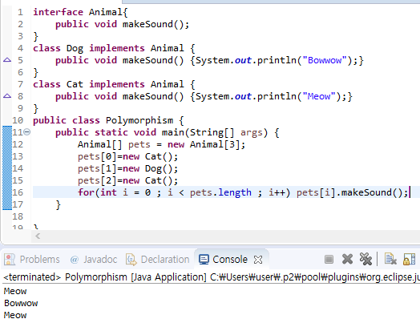
Example

Slide 21
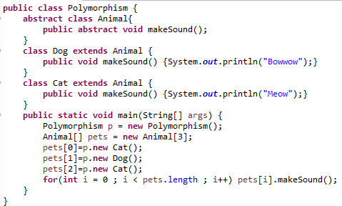
Inner class
A nest class (a class within a class)
The purpose of nested classes is to group classes that belong together, which makes your code more readable and maintainable.
Inner class

Slide 22
Static variable
belongs to the class as a whole, and not just to one object
There is only one copy of a static variable per class
Although a static method cannot access an instance variable, a static method can access a static variable
A static variable is declared like an instance variable, with the addition of the modifier static
If not explicitly initialized, a static variable will be automatically initialized to a default value
private static int myStaticVariable;
private static int myStaticVariable = 0;

Slide 23
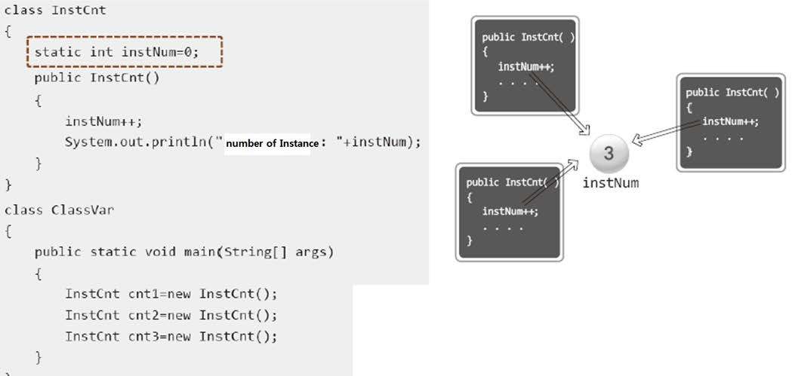
Example

Slide 24
Static methods
It can be used without a calling object
A static method still belongs to a class
When a static method is defined, the keyword static is placed in the method header
public static returnedType myMethod(parameters)
{ . . . }
Static methods are invoked using the class name in place of a calling object
returnedValue = MyClass.myMethod(arguments);

Slide 25
Data Structures . Advanced Java
Array

Slide 26


Array
A collection of a same type of objects
variable
15
code:
int variable = 15;
0
1
2
3
index
array
1 2 3 4
int[] variables = {1,2,3,4};
code:

Slide 27
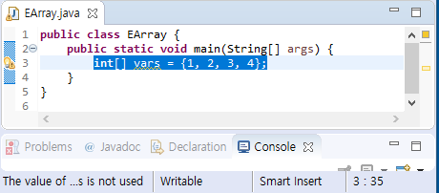

Slide 28
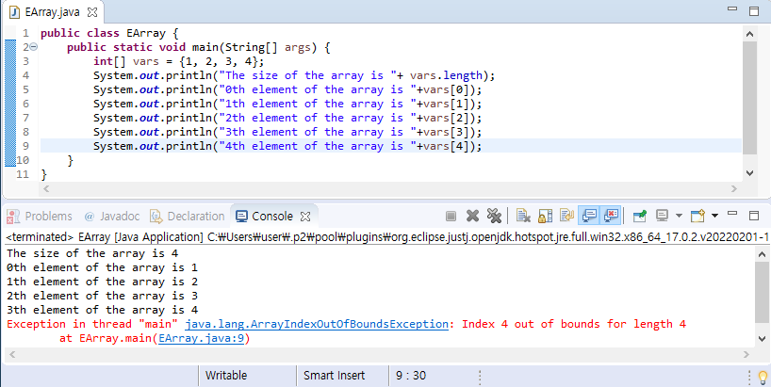
-
X

Slide 29
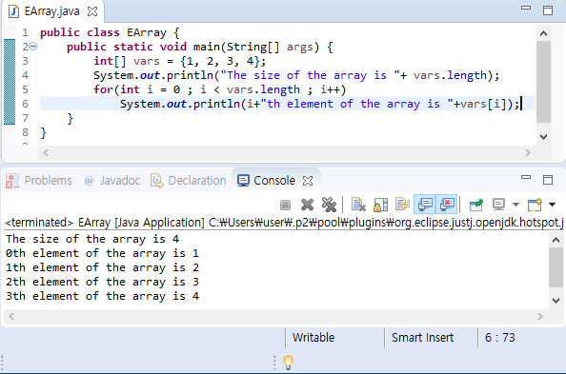
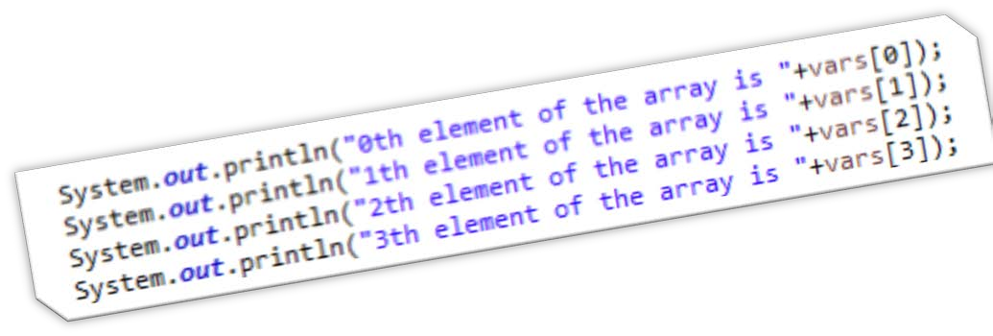
-
X

Slide 30
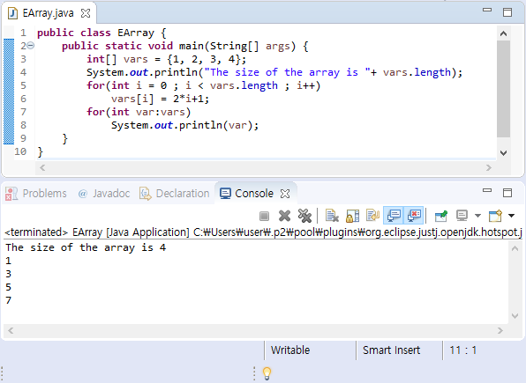
-
X

Slide 31


Problem of an array
What happens If you want to store more numbers
0
1
2
3
•
Room[ ] hotel = new Room[4];

Slide 32



-
X
Predicting the future
is not easy.
ArrayList

Slide 33
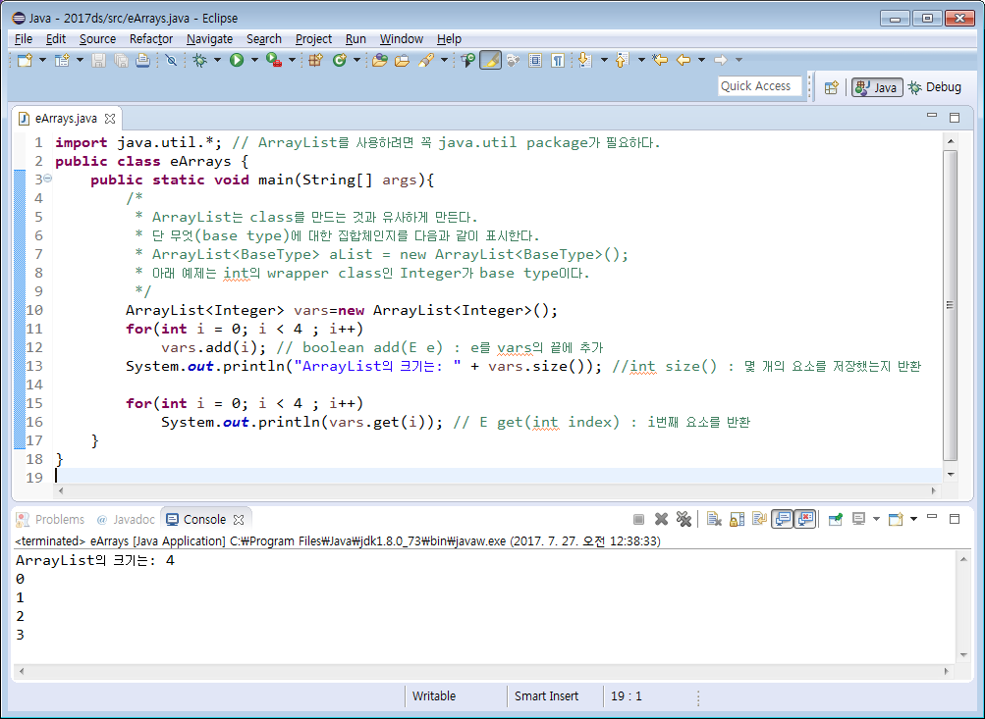


vars.add_{v}(_{a}i_{r})_{s};_{.size();}
-
X
vars.get(i);

Slide 34
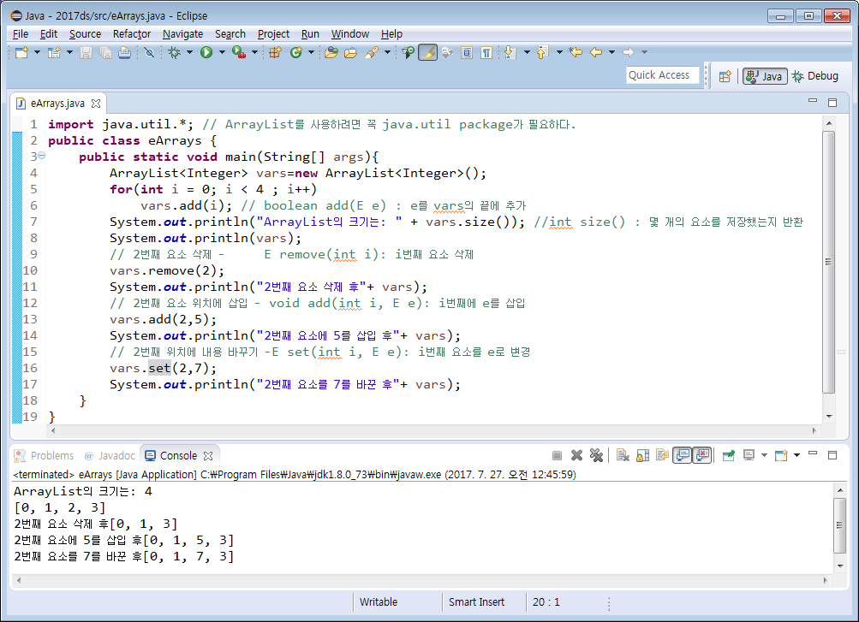
-
X

Slide 35
-
X
•
Choice
array ArrayList
•
•
size can change
for only classes
!use Wrapping class for primitive type

Slide 36
Data Structures . Advanced Java
Generics

Slide 37
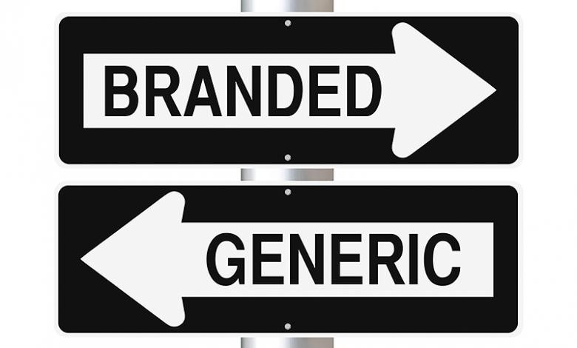

Would you like the generic drug or a name brand?
-
X

Slide 38






Generic
generic
base type

Slide 39
Generics
parameterized class
example
ArrayList<BaseType>
Glass<Coke> or Glass<Pepsi>

Slide 40

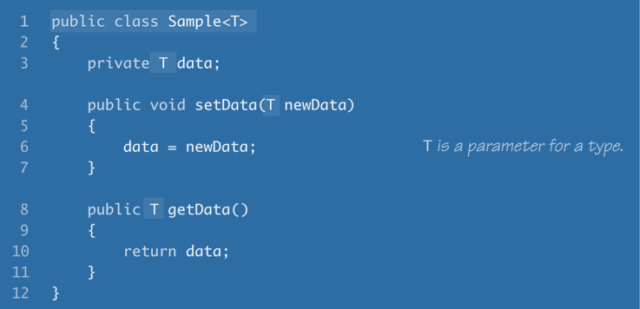

-
X
parameter
the data type for a member variable
a parameter type of a method
a return type of a method

Slide 41
-
X
public class Sample<T1, T2> {
// 2 parameters: T1 and T2
private T1 d1; { // declare d1 whose type is T1 private T2 d2; // declare d2 whose type is T2 public Sample() {
d1=null; d2=null;
}
public void setData(T1 d1, T2 d2) {
this.d1 = d1; this.d2 = d2;
}
public T1 getData1() {
return d1;
}
public T2 getData2() {
return d2;
}
public String toString() {
return d1 + ", "+d2;
}
}
public class SampleDemo {
public static void main(String[] args) {
// determine T1 and T2 as Integer and String, respectively Sample<Integer,String> s = new Sample<Integer,String>(); s.setData(new Integer(3), new String("Hello")); System.out.println(s);
}
}

Slide 42
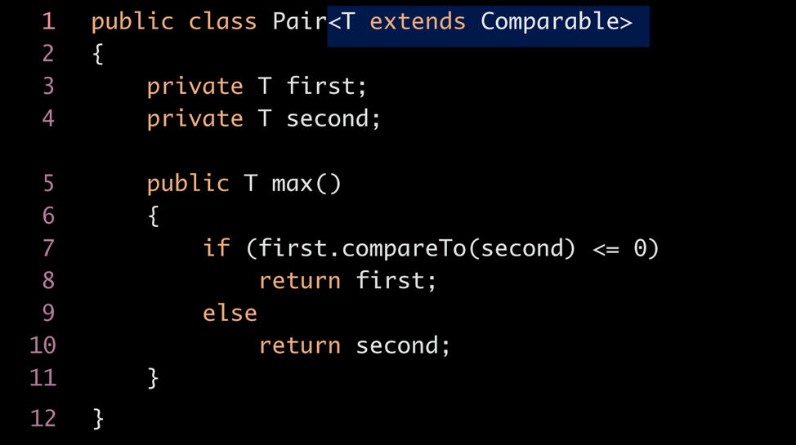
-
X
One of T’s ancestor or T itself implements Comparable. So, first can use method compareTo

Slide 43

-
X
Generics = parameterized class
A box that can hold anything

Slide 44
Thank you!
-
X
Questions?
Exit

